Slide 1
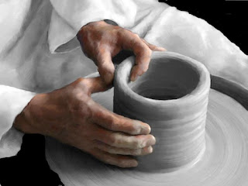
Learn how to build Machine Learning Models in C# using ML.NET
Ron Dagdag
This Photo by Unknown Author is licensed under CC BY-NC-ND

Slide 2

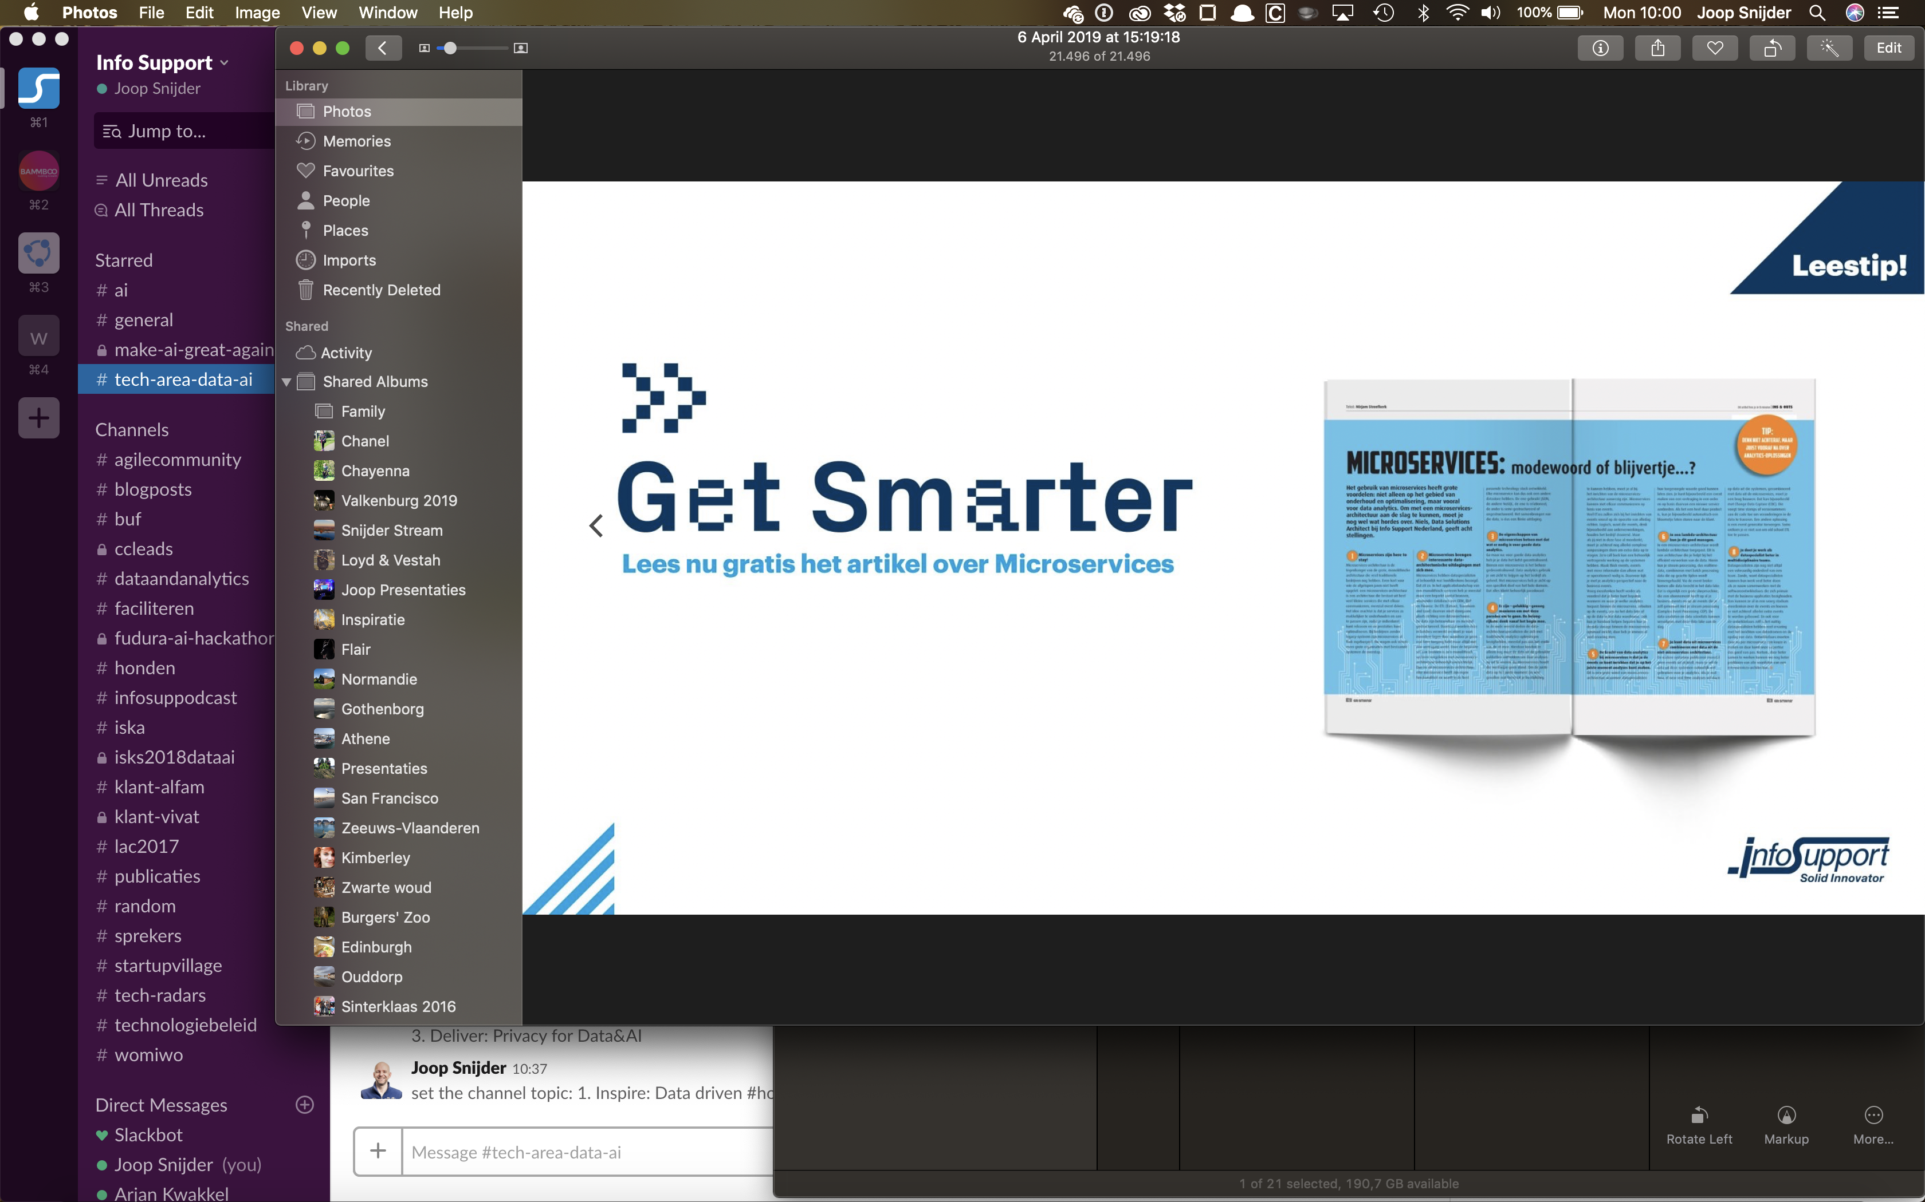
Ron Dagdag
Crestron Electronics
Microsoft MVP Award
@rondagdag
ron@dagdag.net
http://www.dagdag.net/

Slide 3
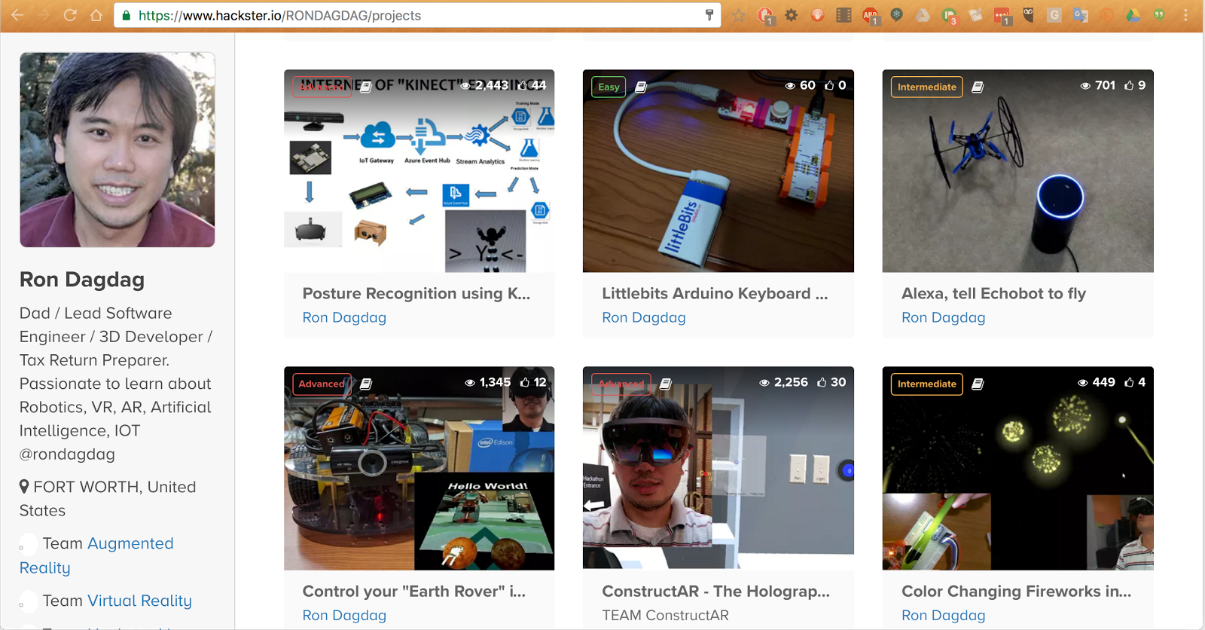
Hackster Portfolio www.dagdag.net @rondagdag
Notes:
Azure Machine Learning Services gives you an end-to-end solution to prepare data, and train your model in the Cloud.
Just modify your training scripts to save an ONNX file.
WinMLTools converts existing models from CoreML, scikit-learn, LIBSVM, and XGBoost
WinMLTools is a python package that you can pip install to perform conversions.

Slide 4

Let’s ask the audience

Slide 5
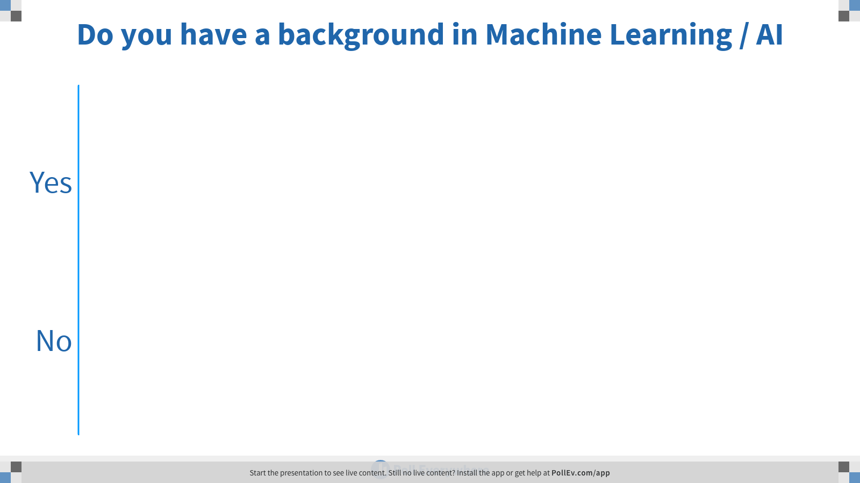
Notes:
Poll Title: Do you have a background in Machine Learning / AI https://www.polleverywhere.com/multiple_choice_polls/UEDYvbxADMtHWe5a3psoE

Slide 6
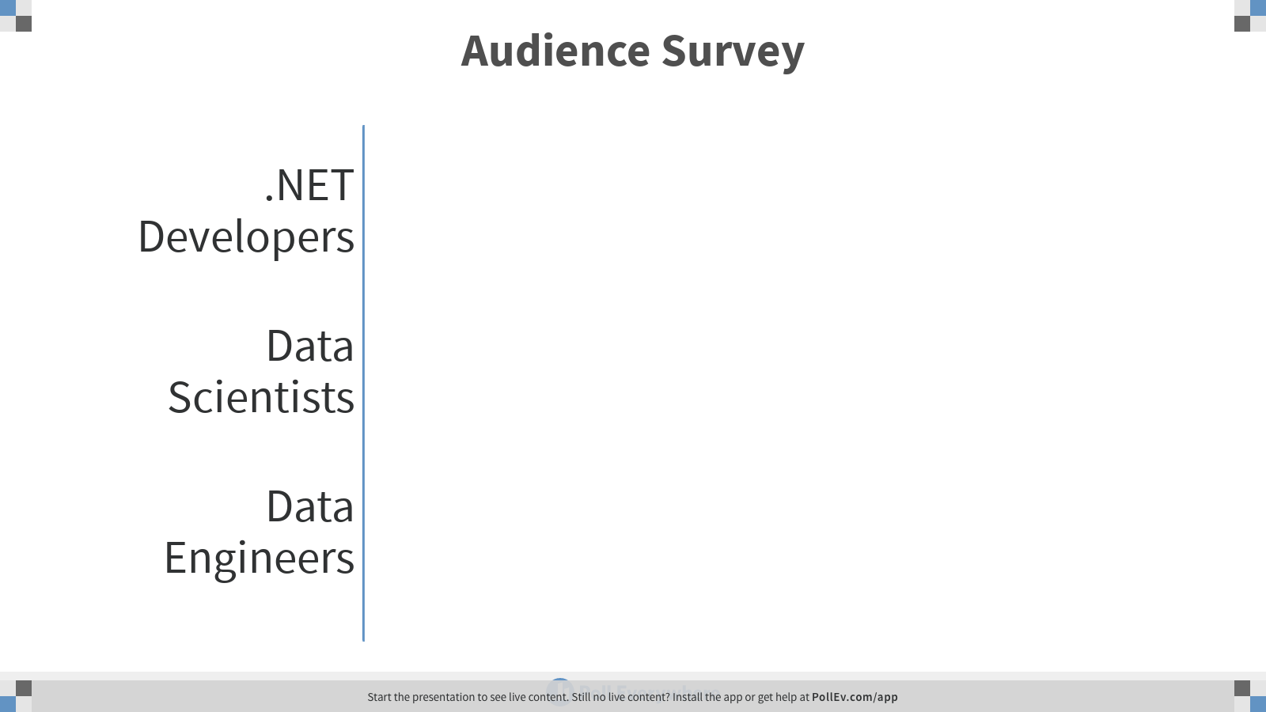
Notes:
Poll Title: Audience Survey https://www.polleverywhere.com/multiple_choice_polls/1PKj2SCOuJ0IIHkhKdOGx

Slide 7
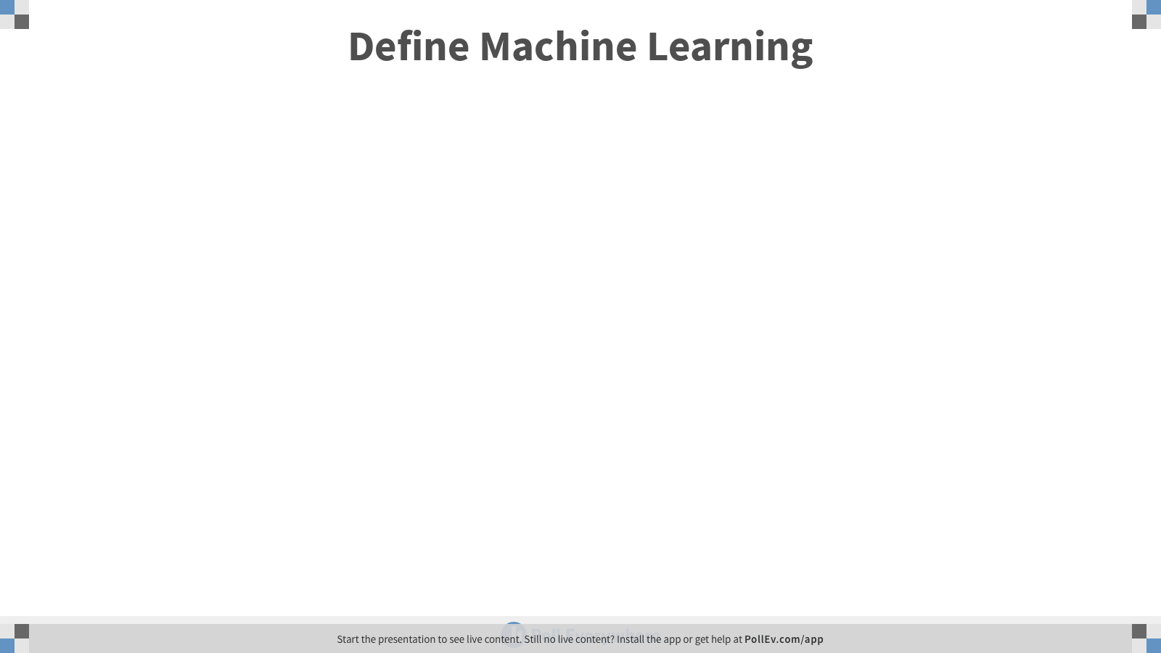
Notes:
Poll Title: Define Machine Learning https://www.polleverywhere.com/free_text_polls/7XdZ68tN6ApzSGKg9QWZx

Slide 8
What are we trying to solve here?

Slide 9

programming
algorithm
answers
input

Slide 10
machine learning
answers
algorithm
input

Slide 11
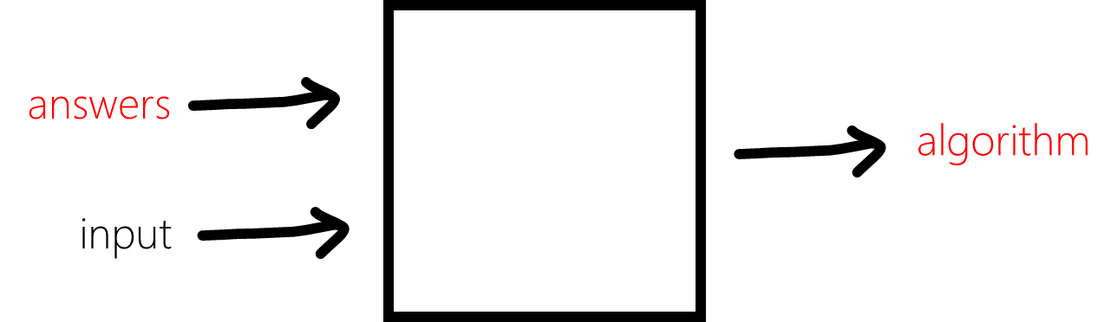
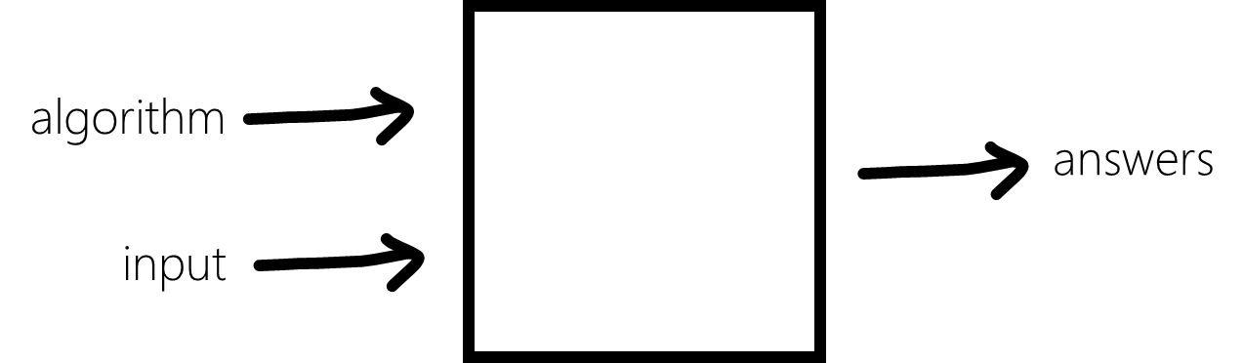
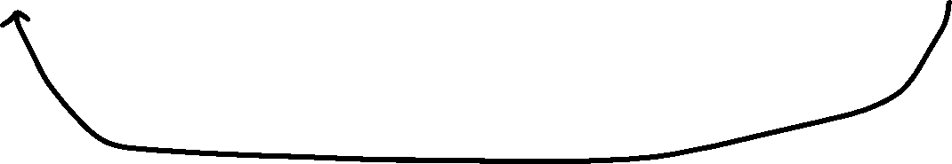
ML Primer
Inferencing
Machine learning
Programming
Training
Data
Training
Framework
Model
Model
Runtime

Slide 12

Machine Learning “Programming the UnProgrammable”
{
{
Is this a face?
Price of Shirt?
f(x)
f(x)
“It has exquisite buttons … with long sleeves …works for casual as well as business settings”

Slide 13



Machine Learning “Programming the UnProgrammable”
{
Machine Learning creates a
Face
Face
f(x) Model
Not a face
Not a face
using this data
Notes:
A model is an intelligent function which can predict

Slide 14
Agenda
What is Machine Learning?
Create ML models
Deploy ML models to ASP.NET core

Slide 15
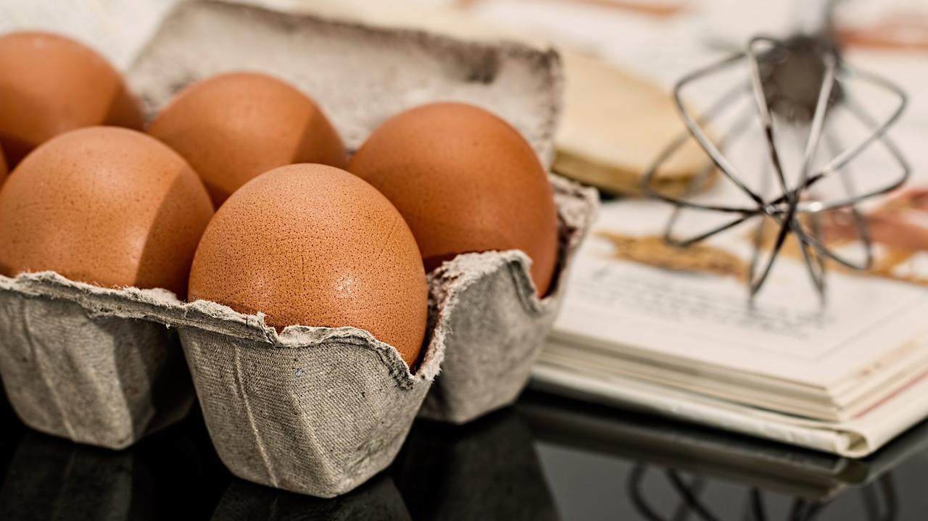
Secret Recipe

Slide 16


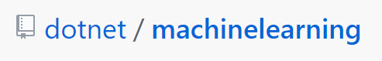
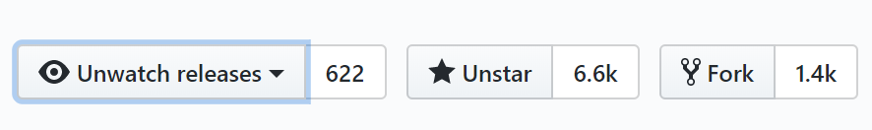
150K+
Downloads
ML.NET Open Source Momentum
1,960
Commits
2,063
Pull requests
135
Contributors

Slide 17

ML.NET 1.0 @Build 2019
ML.NET
Machine Learning framework for building custom ML Models Custom ML made easy Automated ML and Tools (Model Builder and CLI) Proven at scale Azure, Office, Windows
Extensible TensorFlow, ONNX and Infer.NET Cross-platform and open-source Runs everywhere

Slide 18
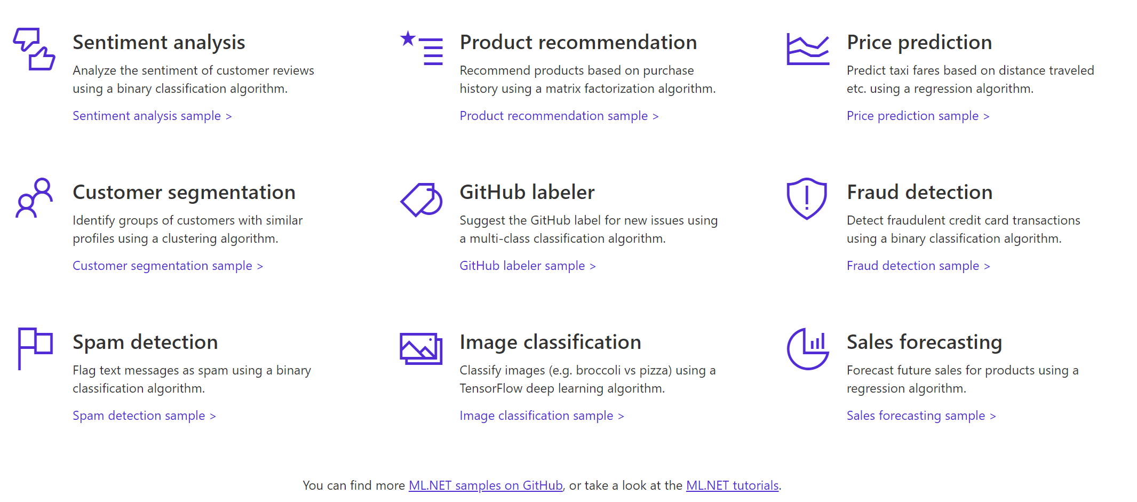

A few things you can do with ML.NET 1.0 …

Slide 19
Machine Learning Problem Example
How much is this car worth?

Slide 20
Model Creation Is Typically Time-Consuming
Which features?
Which algorithm?
Which parameters?
Mileage
Condition
Car brand
Year of make
Regulations
…
Gradient Boosted
Nearest Neighbors
SVM
Bayesian Regression
LGBM
…
Parameter 1
Parameter 2
Parameter 3
Parameter 4
…
Mileage
Gradient Boosted
Criterion
Loss
Min Samples Split
Min Samples Leaf
Others
Car brand
Year of make
30%
Model

Slide 21
Model Creation Is Typically Time-Consuming
Which features?
Which algorithm?
Which parameters?
Mileage
Condition
Car brand
Year of make
Regulations
…
Gradient Boosted
Nearest Neighbors
SVM
Bayesian Regression
LGBM
…
Criterion
Loss
Min Samples Split
Min Samples Leaf
Others
Mileage
Gradient Boosted
N Neighbors
Weights
Metric
P
Others
Condition
Nearest Neighbors
Car brand
Car brand
50%
Year of make
30%
Year of make
Model
Iterate

Slide 22
Model Creation Is Typically Time-Consuming
Which features?
Which algorithm?
Which parameters?
30%
50%
70%
30%
45%
50%
65%
95%
35%
10%
75%
20%
70%
30%
15%
Iterate

Slide 23
Automated ML Accelerates Model Development
Input
Intelligently test multiple models in parallel
Output
25%
Optimized model
25%
40%
Enter data
70%
25%
40%
70%
95%
95%
Define goals
25%
40%
70%
25%
40%
25%
70%
Apply constraints
40%

Slide 24

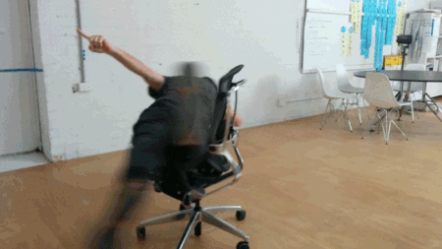
Time to give AutoML a spin!
Model Builder Visual Studio Extension
https://marketplace.visualstudio.com/items?itemName=MLNET.07

Slide 25
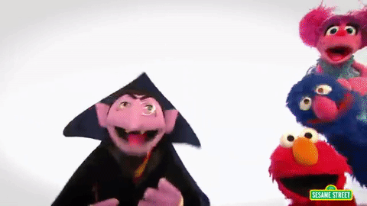
Three key concepts

Slide 26
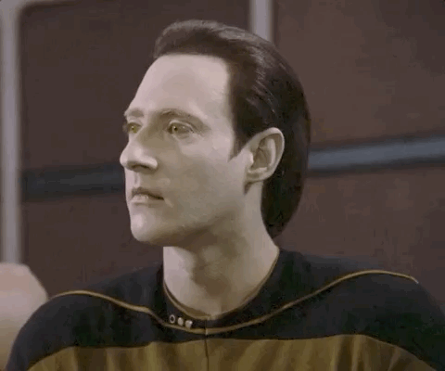
1. Data
Data
Example
Comment Text | Sentiment
Wow... Loved this place. | 1
Crust is not good. | 0
Not tasty and the texture was just nasty. | 0
The selection on the menu was great. | 1
Notes:
Dataset: https://github.com/dotnet/machinelearning/blob/master/test/data/wikipedia-detox-250-line-data.tsv

Slide 27
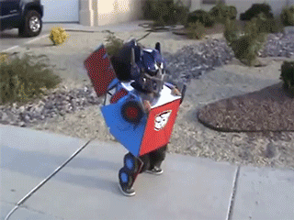
2. Transformers
Data
Data
Transformer
Data
Example
Text
Wow... Loved this place.
Crust is not good.
Not tasty and the texture was just nasty.
The selection on the menu was great.
Featurized Text
[0.76, 0.65, 0.44, …]
[0.98, 0.43, 0.54, …]
[0.35, 0.73, 0.46, …]
[0.39, 0, 0.75, …]
Text Featurizer
Notes:
Transformers take data, do some work on it, and return new transformed data.
One example of a transformer we will need in our example is a Text Featurizer, which takes the text in the issue text and converts it to numbers that our ML algorithms can understand.

Slide 28

3. Estimators
Data
Data
Transformer
Data
Data
Estimator
Transformer
Example
Comment | Sentiment
Wow... Loved this place. | 1
Crust is not good. | 0
Not tasty and the texture was just nasty. | 0
The selection on the menu was great. | 0
Estimator
Model (Transformer)
Notes:
An estimator learns from data to create a transformer. Now a model, which turns the input features into output predictions, is a transformer. So we can take estimators that take our example data and produce a model.

Slide 29
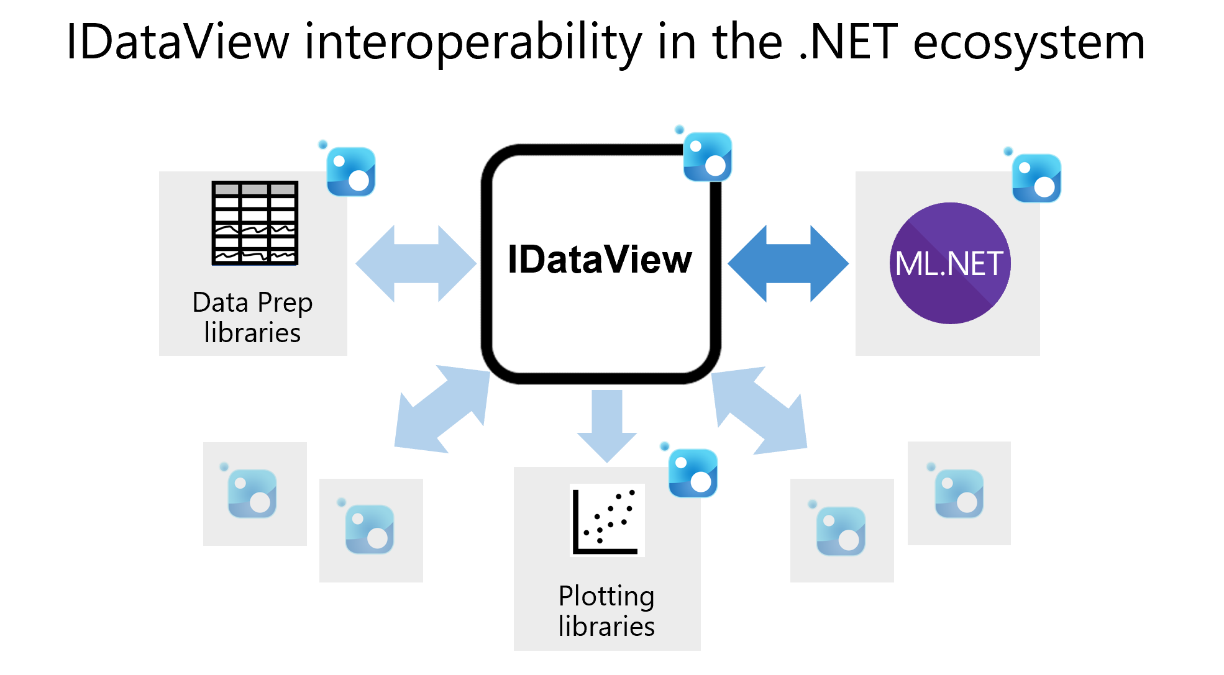
IDataView

Slide 30
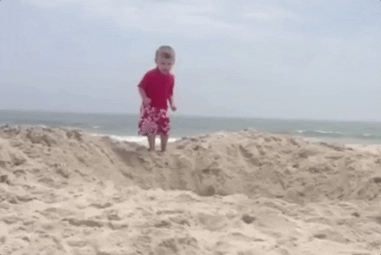
Let’s look deeper at ML.NET

Slide 31
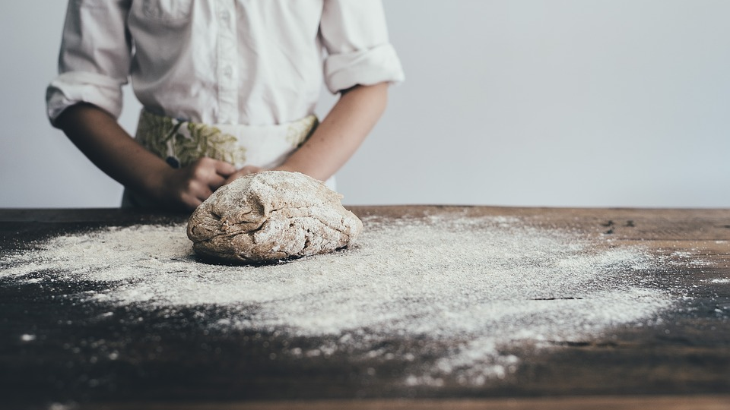
Baker vs Starting a Bakery

Slide 32
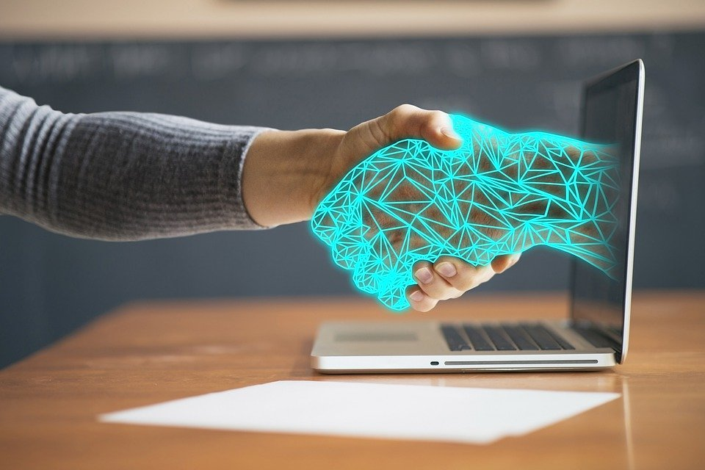
Integrate our model into ASP.NET Core

Slide 33
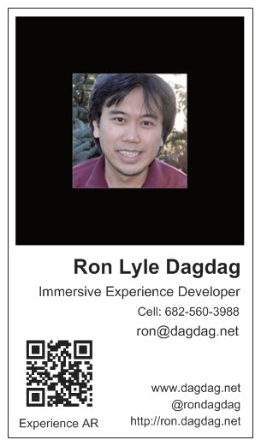
Ron Dagdag
Sr. Software Engineer/Voice AI Assistant Specialist at Crestron Electronics
Microsoft MVP award
Hackster DFW Ambassador meetup.com/Hackster-DFW
Dallas Littlebits Chapter Leader meetup.com/amRobotics
Dallas AR/VR Development meetup meetup.com/Dallas-Virtual-Reality
"Opinions expressed are solely my own and do not express the views or opinions of my employer."
Notes:
Azure Machine Learning Services gives you an end-to-end solution to prepare data, and train your model in the Cloud.
Just modify your training scripts to save an ONNX file.
WinMLTools converts existing models from CoreML, scikit-learn, LIBSVM, and XGBoost
WinMLTools is a python package that you can pip install to perform conversions.

Slide 34
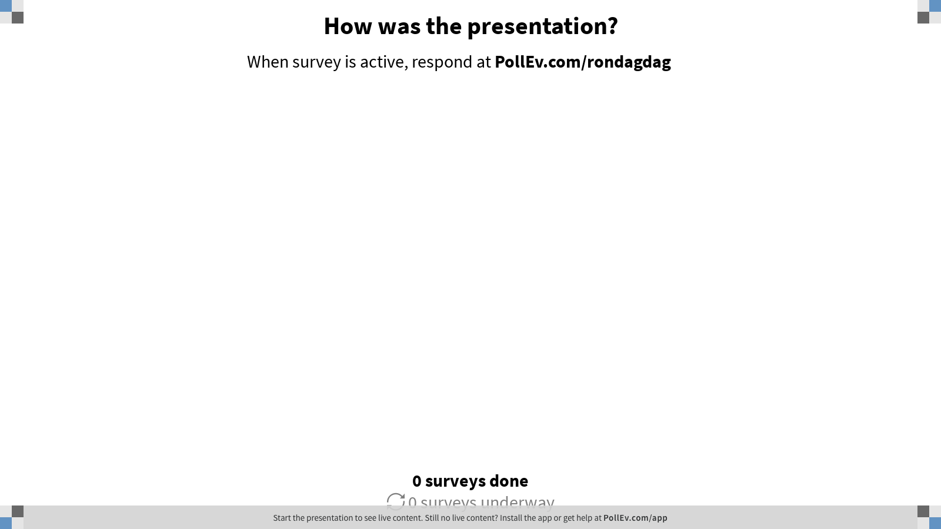
Notes:
Poll Title: How was the presentation? https://www.polleverywhere.com/surveys/toxVzhr7263Q6A68or5Oe

Slide 35
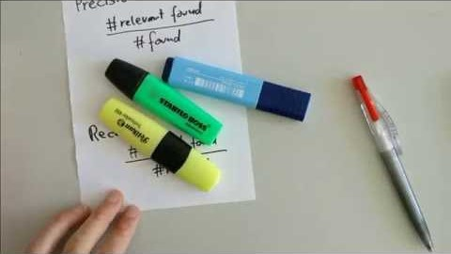
Precision and Recall in 100 Seconds

